Slide 1
Donating strategically this holiday season
Your guide to multiplying the social impact of your donations
Winter 2023

Slide 2
Short on time? Improve thousands of lives in less than 5 minutes
DONATE
MATCH
BE PROUD!
1
2
3
Give to an effective charity of your choice, or lean on the expertise of GiveWell, an independent charity evaluator) by donating to their Top Charities Fund, and they will make sure your donation goes to the charities that need it most.
If your company has a donation matching program, leverage it to double your impact!
This is you!
You just changed the world!
Give Now
Explore Whether Your Company Matches Here
Note: These donations are likely tax-deductible. Include the donation in your tax return form!
See appendix for an overview based on your country
www.givewell.org/charities/top-charities

Slide 3
EXECUTIVE SUMMARY:
You can save more lives than a doctor by donating strategically¹
As consultants, most of us strive to create a positive social impact in our private and professional lives
Donating strategically is relatively neglected as few of us take an investment approach to our donations
You yourself are uniquely positioned to do a lot of good and create a substantial positive impact
If you’re reading this, you likely belong to the richest 1% of the world’s population
You have the consulting mindset that drives you to follow the data and find outlier impact opportunities
You can multiply your impact ×10-100 vs typical donations by strategically prioritizing nonprofits
Donating makes you happy. According to research, donating will likely boost your happiness and wellbeing
WHY
Best-in-class charities focus on addressing one of the world’s most pressing problems, are highly cost-effective, and evidence-backed
Donate now to a charitable fund managed by experts, or pick your own high-impact charities, all of which radically outperform their peers’ impact
Learn more about how to maximize the ROI of your donations on givewell.org and join the Effective Altruism Consulting Network
HOW
1. According to researchers at 80000hours.org

Slide 4
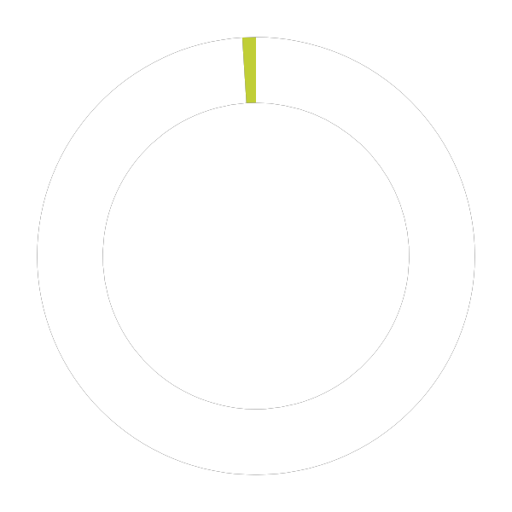
WHY
You are uniquely positioned to do a lot of good
With an annual income of $100,000, you…
… all while having dramatically improved the lives of of up to
1%
5,000 people
Belong to the richest 1% of the world’s population^{1.}...
by protecting them from malaria for 3 years when donating to the Against Malaria Foundation ²
Can donate 10% of your income and still be in the richest 1%¹…
99%
Smaller commitments are also extremely valuable, as an individual long-lasting insecticidal net costs less than $6 USD and malaria kills over 400,000 people annually
People richer than me
People I am richer than
This is just one sample impact illustration – See page 11 for other high impact donation options
1. Giving What We Can 2. GiveWell; Cost-effectiveness may vary between regions

Slide 5
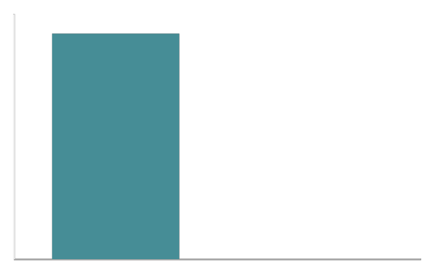
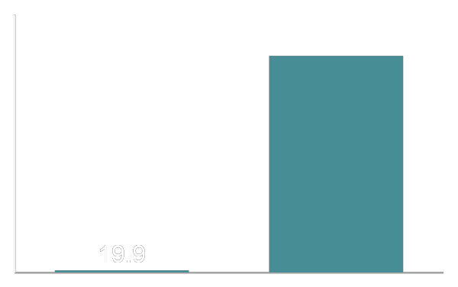
WHY
Few donors think strategically about their charitable impact
Typically, money is donated to popular causes instead of high-impact causes
Few people assess the ROI of their donations in the way they do for other investments
Why not take an investment approach to your donations with the goal of maximizing your impact?
The majority of animal suffering is experienced by animals who live on farms …
… however, the majority of donations aimed at improving animal welfare go to shelters
Animals in Millions (USA)
Money donated in $Millions (USA)
10,000
9,200
2,500
2,100
8,000
2,000
6,000
1,500
4,000
1,000
2,000
500
3
0
0
Animals killed and used in farms
Animals living in shelters
Farms
Shelters
Source: Animal Charity Evaluators, 2016

Slide 6
WHY
You can multiply your impact ~140x depending on which program you support
Helping 1 person is great – helping more people is even better
Best-in-class charities radically outperform their peers in terms of impact generated
Where you donate is more important for your overall impact than how much you donate
How much good can you do with $40,000 USD?
LOCAL
GLOBAL
Provide 1 guide dog for a blind person in a developed country
Fund 1,400 eye operations to fully restore sight in Uganda
Source: The Life You Can Save; Sightsavers

Slide 7
WHY
Why is effective, rational donating so neglected?
Challenge
Heart crowds out head
Lack of transparency when it comes to impact
Preference for giving locally
Emotionally driven preference for personal stories over statistics
Giving makes us feel good; thinking critically can undermine this effect
Minimal trustworthy information from NGOs about their actual impact (e.g., # of lives saved)
Low motivation to donate due to doubt that the donation will amount to any real impact
Local organizations feel easier to donate to than international, “intangible” organisations
In practice, the impact of donating in developing countries is often much higher since the need is greater
Solution
Combine your heart and head: use your heart to motivate yourself to give to others and then use your head to ensure that your donation is effective and impactful¹
Use the The Life You Can Save’s impact calculator or refer to GiveWell to assess how much each dollar can achieve with effective charities; trust expert-led charitable funds.
Visualize the 1 person your $ could help locally vs the 140 people you could help with the same amount by expanding your geographic horizons
1. For example, by leveraging professional charity evaluators such as GiveWell | Sources: Giving What We Can, GiveWell, The Life You Can Save

Slide 8
WHY
Donating boosts your happiness more than accumulating wealth
Increasing your wealth has diminishing returns on your happiness
Other than the impact, why donate?
Income in $K
Happiness Research shows that spending our bonuses on helping others will likely boost happiness
70
Purpose Giving enables us to become part of building a better world
Diminishing marginal utility of income – each additional $ earned brings less happiness than the previous one. On the other hand, donating can continuously & significantly boost your happiness
Justice Alleviating poverty for those less fortunate than us will make the world more equitable
Financial benefits Donating to effective charities is tax-deductible in most countries (see appendix)
Happiness
Source: Money and Happiness; Bonus and Happiness

Slide 9
It is more difficult to give money away intelligently than to earn it in the first place.
“
Andrew Carnegie, The Gospel of Wealth, 1889

Slide 10
HOW
Prioritize cost-effectiveness when deciding where to donate
How urgent
is the issue the charity is addressing?
How evidence-backed is the charity’s
approach?
What is the scale of the problem? Is the problem neglected by others?
Is it solvable?
What drives the charity’s decisions?
Are there reliable internal or external evaluations of their work?
Is the charity transparent?
How cost-effective is the charity in achieving its goals?
How far does a dollar go?
How far will my marginal dollar or donation go?
Check out GiveWell to learn how to have more impact with your donation

Slide 11
HOW
Donate Now: Support best-in-class organizations
Most pressing problems
Global Health
Climate Change
Long-term Future
Animal Suffering
Selection of best-in-class organizations*
Against Malaria Foundation
Clean
Air Task Force
Future Cleantech Architects
Centre on Long-Term Risk
The
Humane League
The Good Food
Institute
New Incentives
CHAI
With a $1000 donation, you can protect 142 children from malaria. Impact report here
With a $1000 donation, you can vaccinate 6 infants against 7 diseases. Impact report here
Reduce CO2₂ emissions with smart advocacy and tech investments
Reduce CO2₂ emissions with the effective protection of our rainforests
Mitigate negative impacts of AI on society
Invest in research to increase the quality of life for generations to come
Spare animal lives with targeted outreach to companies
Spare animal lives with the development of meat alternatives
Impact of your donation
Donate here
Donate here
Donate here
Donate here
Donate here
Donate here
Donate here
Donate here
*Find more best-in-class organizations here.
Sources: 80000hours.com; The Life You Can Save; GiveWell; Founders Pledge; ACE
See appendix for tax-deductible options in your country

Slide 12
HOW
Leverage expert-led charitable funds
Most pressing problems
Global Health
Climate Change
Long-term Future
Animal Suffering
Selection of expert managed funds*
GiveWell’s Top charities Fund
Founders Pledge’s Climate Change Fund
Long-Term Future Fund
Animal Welfare Fund
The cost of saving a life through the GiveWell Top Charities Fund is estimated to be $5,500. Learn more about GiveWell estimations here.
The Founders Pledge’s Climate Change Fund is targeted towards neglected solutions, audacious advocacy and low-carbon innovation. Learn more about the fund’s rationale here.
The Long-Term Future Fund Address potential risks from advanced artificial intelligence, build infrastructure and advocate for global catastrophic risk projects. More info on the fund can be found here.
The Animal Welfare Fund is focused on neglected geographic regions or groups of animals, and on promising research into animal advocacy and well-being. More info here.
Potential impact of your donations
Donate here
Donate here
Donate here
Donate here
*Find more expert-led funds here.
Sources: 80000hours.com, Giving What We Can, GiveWell, Founders Pledge, EA Funds
See appendix for tax-deductible options in your country

Slide 13
How wonderful it is that nobody need wait a single moment before starting to improve the world.
“
Donate now
Donate regularly
Anne Frank

Slide 15
Sign-up for the Effective Altruism Consulting Network newsletter if you want to receive more tailored insights on how to maximize your positive impact as a consultant
Subscribe Now

Slide 16
Want to learn more about doing good strategically?
Tailored advice for consultants
The science of doing good
TED talk Effective Altruism

Slide 17
Tax-deductible donations to effective charities using local grantmaking organisations
Organisation | Causes | Tax-deductible countries
Giving What We Can | Various | United States, United Kingdom, Netherlands
One for the World | Global Health | United States, United Kingdom, Canada, Australia
GiveWell | Global Health | United States, Netherlands
Animal Charity Evaluators | Animal Suffering | United States, Netherlands
Long-Term Risk Fund | Long-term Future | Germany, Switzerland, Netherlands
RC Forward | Various | Canada
Effective Altruism Australia | Global Health | Australia
Effektiv Spenden Schweiz | Various | Switzerland
Effective Altruism New Zealand | Global Health | New Zealand
The Life You Can Save | Global Health | United States, United Kingdom, Australia, Netherlands
Fundación Ayuda Efectiva | Global Health | Spain
Effektiv Spenden | Various | Germany, Czech Republic
Effektiv Altruisme | Various | Norway
Gi effektivt | Global Health | Norway
Ge effektivt | Global Health | Sweden
Doneer Effectief | Various | Netherlands
Giv Effektivt | Global Health | Denmark

